Slide 1

Web Development 1
© Hugh McCabe & Matt Smith 2008-2014
Lecture 5c
CSS descendent selectors

Slide 2
Introduction
What if we want to make just one heading red?
Or make one paragraph in small font, the others in medium?
There are a number of different selector types that allow us to do exactly this.
Today we’ll look at a fourth kind of CSS selector:
Element selector
Group selector (using the comma)
Class selectors
Descendant selectors

Slide 3
In fact there are MANY types of selector …
W3c examples of all the selector types …
http://www.w3.org/TR/CSS2/selector.html#pattern-matching

Slide 4
Pattern | Meaning | Described in section
* | Matches any element. | Universal selector
E | Matches any E element (i.e., an element of type E). | Type selectors
E F | Matches any F element that is a descendant of an E element. | Descendant selectors
E > F | Matches any F element that is a child of an element E. | Child selectors
E:first-child | Matches element E when E is the first child of its parent. | The :first-child pseudo-class
E:link E:visited | Matches element E if E is the source anchor of a hyperlink of which the target is not yet visited (:link) or already visited (:visited). | The link pseudo-classes
E:active E:hover E:focus | Matches E during certain user actions. | The dynamic pseudo-classes
E:lang(c) | Matches element of type E if it is in (human) language c (the document language specifies how language is determined). | The :lang() pseudo-class
E + F | Matches any F element immediately preceded by a sibling element E. | Adjacent selectors
E[foo] | Matches any E element with the "foo" attribute set (whatever the value). | Attribute selectors
E[foo="warning"] | Matches any E element whose "foo" attribute value is exactly equal to "warning". | Attribute selectors
E[foo~="warning"] | Matches any E element whose "foo" attribute value is a list of space-separated values, one of which is exactly equal to "warning". | Attribute selectors
E[lang|="en"] | Matches any E element whose "lang" attribute has a hyphen-separated list of values beginning (from the left) with "en". | Attribute selectors
DIV.warning | Language specific. (In HTML, the same as DIV[class~="warning"].) | Class selectors
E#myid | Matches any E element with ID equal to "myid". | ID selectors

Slide 5
Descendant Selectors
– SPACEs
li em {
color: red;
}

Slide 6
Descendant Selectors
You may already have seen one used previously:
dt strong {color: maroon; }
A descendent selector targets elements that are contained within (and therefore descendants of) another element
Descendent – child, or child of a child, of child of a child of a child etc.
indicated by list of element types separated by spaces
For example to target em elements that appear inside list items li we would use:
li em { color: olive; }

Slide 7
Descendant Selectors How to ‘read’ them like a browser …
Read this:
p strong {color: maroon; }
As:
for “strong” elements found inside “p” elements
make text colour ‘maroon’
(you do this one !) Read this:
li em {color: olive; }
As:
Write your answer here:

Slide 8
/* descend.css */
li em {color: olive; }
<!DOCTYPE html><html>
<head><title>Lecture 6 Example 1</title>
<style type="text/css">
@import "css/descend.css";
</style></head><body>
<p>Here is a paragraph of text that contains an <em>emphasised</em> element. In fact it contains <em>two</em> of them. Below is an unordered list where the latter two elements are also emphasised. Note that they change colour because the style rule only targets em elements that are inside list items.</p>
<ul>
<li>First one</li>
<li><em>Second one</em></li>
<li><em>Third one</em></li>
</ul></body></html>

Slide 9
Descendant Selectors - Example
html
head
body
title
meta
style
p
ul
does NOT apply to
(since NOT inside <li>)
em
em
li
li
li
X
li em {color: olive; }
applies to
em
em

Slide 10
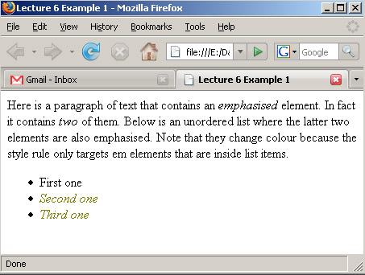
Descendant Selectors - Example

Slide 11
Descendant Selectors
We can also have descendent selectors several layers deep.
For example:
p a strong { font-variant: small-caps; }
This selector targets strong elements that appear inside a elements that in turn appear inside p elements.

Slide 12
Descendant Selectors How to ‘read’ them like a browser …
(you do this one !) Read this:
footer li p { background-color: blue; }
As:
Write your answer here:

Slide 13
Summary and Conclusions

Slide 14
Summary / Conclusions …
Descendent selectors (a child, or grandchild etc.)
SPACE between selectors, e.g.: nav a { ... }
RECAP:
p { color: red; } /* element selector */
h1, h2 { color: green; } /* grouping selector */
.phone_num { color: pink; } /* class selector */
nav a { text-decoration: none; } /* descendent selector */

